Slide 1

“Image Processing based Traffic Surveillance”
Presented by
D K Chandrakanth 1SI20EC020
Siddharth Prabhu 1SI20EC090
Preetham G M 1SI20EC121
Mithun J B 1SI20EC124
Under the guidance of
A.N Mukunda Rao,
Associate Professor
DEPARTMENT OF ELECTRONICS AND COMMUNICATION
SIDDAGANGA INSTITUTE OF TECHNOLOGY, TUMKUR-3

Slide 2
Contents
Introduction
Motivation
Objectives
Literature Review
Block diagram
Flowchart
Methodology
Software description
Dataset
Results
Conclusion
Scope for future work
References

Slide 3
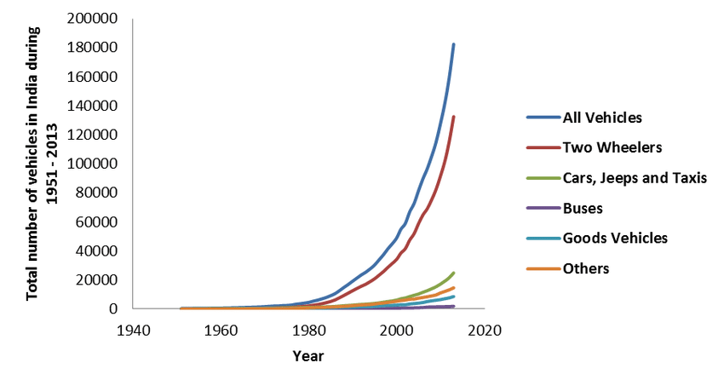
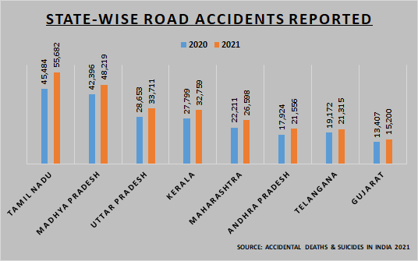
Introduction
India saw an 18% increase in vehicle ownership in 2023.
This increase led to a 12% rise in road accidents.
The surge in vehicles has reduced road safety and resulted in more deaths.

Slide 4
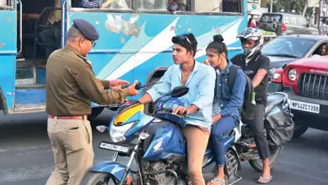
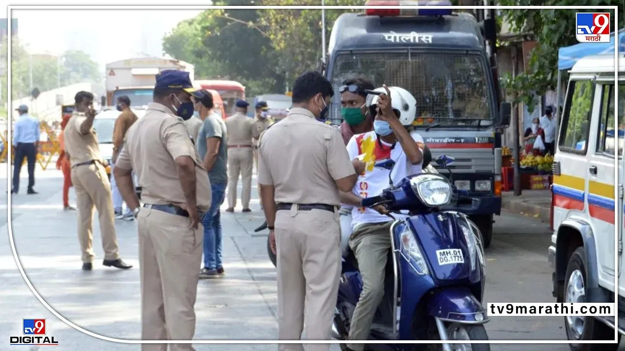
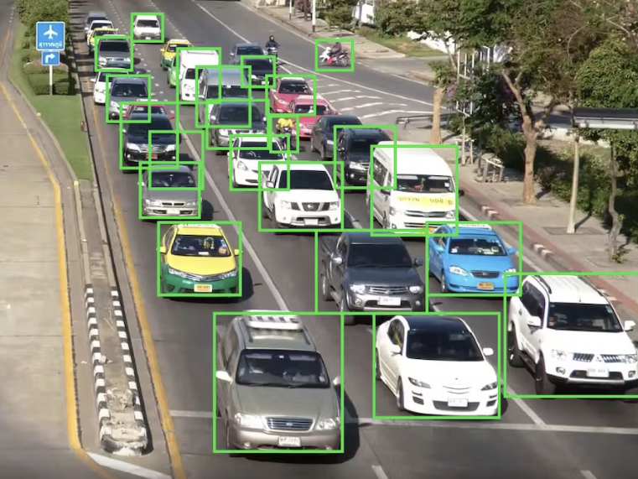
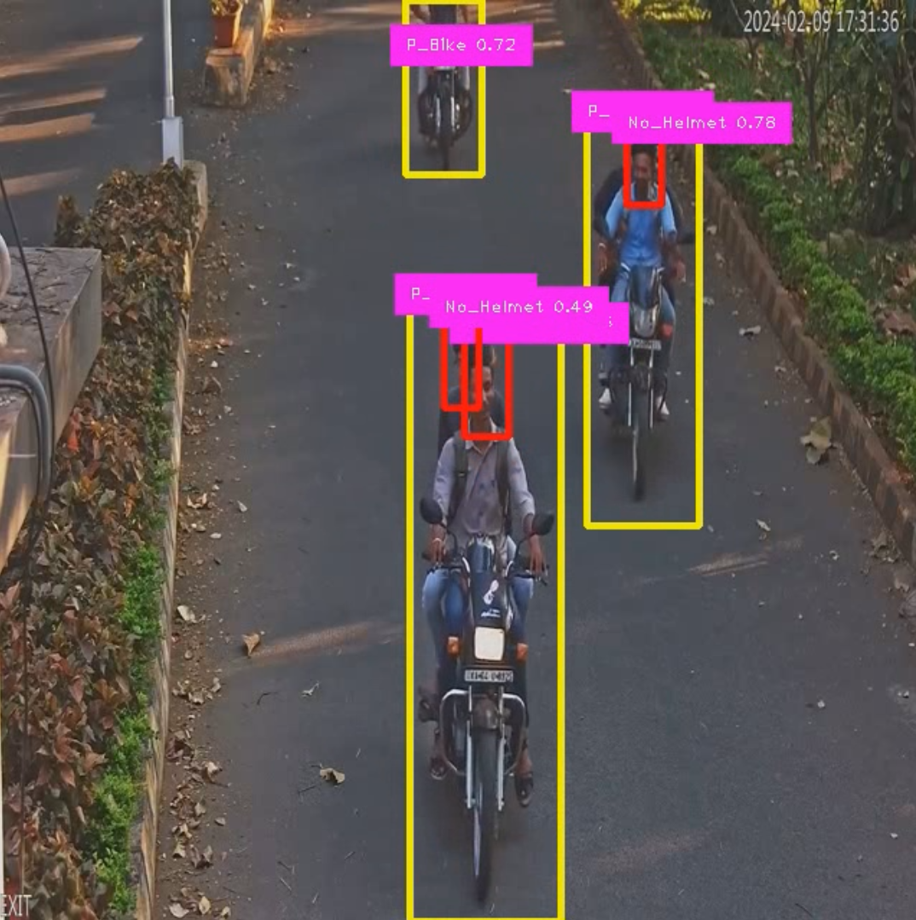
Introduction
Incorporating the law enforcement will be challenging.
To address this issue we propose a fully functional traffic surveillance monitoring system. [Images (a),(b),(c) are the courtesy of google.com]
(a)
(b)
(c)
(d)

Slide 5
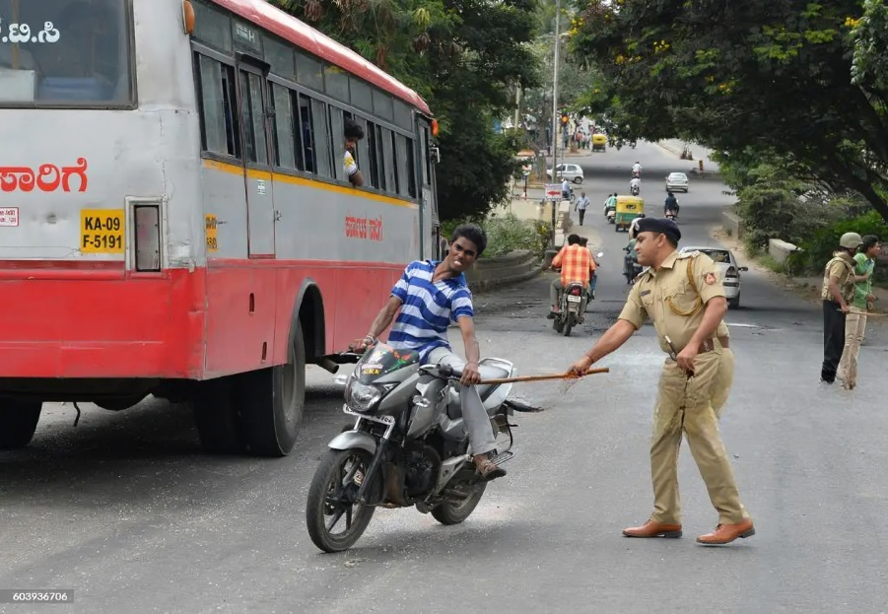
Motivation
Addressing the challenges faced by traffic police, including resource
strain and inconsistent law enforcement.
Automatically monitor and manage various traffic violations.
Eliminating the need for manual monitoring.

Slide 6
Objectives
The objective of this project is to extract the License plate information of the bike and car which violate the traffic rules such as,
Riding bike without Helmet.
Triple riding on bike.
Mobile phone usage while riding the bike.
Bike and car surpassing over the zebra crossing lane in a traffic signal.

Slide 7
Literature Review
SL.No | Author | Year | Topic | Overview
1. | Dahiya .K, Singh D, Mohan C.K. | 2016 | Automatic detection of Bike-riders without helmet using surveillance videos in Real-time. | Detection of motor-cyclists from surveillance video using object segmentation. Determination of helmeted and non-helmeted riders by binary classifier.
2. | Apoorva Saumya, Gayathri.V. | 2020 | Machine Learning based Surveillance System for Detection of Bike Riders without Helmet and Triple Rides. | Vertical projection of binary image is used for counting the number of riders. YOLO based convolutional neural network for object detection.
3. | Madhuchhanda Dasgupta. | 2019 | Automated Helmet Detection for Multiple Motorcycle Riders using CNN. | Motorcycle riders detection by CNN(Bounding boxes, Euclidean distance). Softmax classifier for Helmet detection.

Slide 8
Literature Review
SL.No | Author | Year | Topic | Overview
4. | Xue- Hua Wu, Renjie HU. | 2019 | Block-Based Hough Transform for Recognition of Zebra Crossing in Natural Scene Images. | Block based Hough transform is used to recognize the parallel and straight lines, this detected lines adapted to recognize Zebra crossing.
5. | Mallela Nikhil, Rohit Volety. | 2021 | Detection of triple riding and speed violation on two wheelers using deep learning algorithm. | YOLOv3 used for detecting rule violators. COCO dataset was used to train the YOLO model.
6. | Mistry, Jimit, Aashishk | 2014 | An automatic detection of helmeted and non helmeted motorcyclists with license plate extraction using CNN. | YOLOv2 model is used at two different stages, Detection of person class instead of motorcycle to improve the accuracy. YOLOv2 is implemented for helmet detection. Open ALPR used for license plate extraction.

Slide 9
Literature Review
SL.No | Author | Year | Topic | Overview
7. | Hanhe Lin, Deike Albers. | 2020 | Helmet use detection of tracked motorcycles using CNN based multi-task learning. | RetinaNet is used to detects motorcycle with at least one rider, using both motion state and visual similarity between detected active motorcycle.
8. | Hengliang Shi, Dongnan Zhao | 2023 | License Plate Recognition System Based on Improved YOLOv5 and GRU. | Deep learning model for license plate location and recognition(GRU + CTC used to build the recognition network of license plate).
9. | Waqar Riaz, Abdullah Azeem, Gao Chenqiang, Zhou Yuxi, Saifullah | 2020 | YOLO Based Recognition Method for Automatic License Plate Recognition. | AOLP dataset is used for the license plate recognition. YOLOv3 model is employed for character recognition.

Slide 10
Literature Review Summary
Researchers have explored Convolutional Neural Networks (CNN) for traffic safety.
Focus areas include object segmentation, binary classifiers for helmet detection, and block-based Hough transform for zebra crossing recognition.
Specific applications involve developing binary classifiers for helmet detection and using block-based Hough transform for zebra crossing recognition.
Limitations of the Work:
Existing approaches suffer from less accuracy, lower speed computation, and increased complexity.
Each paper typically develops models for specific tasks, resulting in fragmented solutions.

Slide 11
Literature Review Summary
Integration for Comprehensive Approach:
To overcome limitations, the proposed project integrates these models into a unified system.
The goal is to achieve a comprehensive approach to traffic safety enforcement.
Selection of YOLOv8:
YOLO models are chosen for traffic violation detection due to their speed and accuracy.
YOLOv8 is selected for its ability to be trained on larger datasets and its Multi-Scale Feature Fusion for detecting small objects.
The model's anchor-free bounding box detection capacity aids in non-maximum suppression (NMS) for faster processing, improving both speed and accuracy.

Slide 12
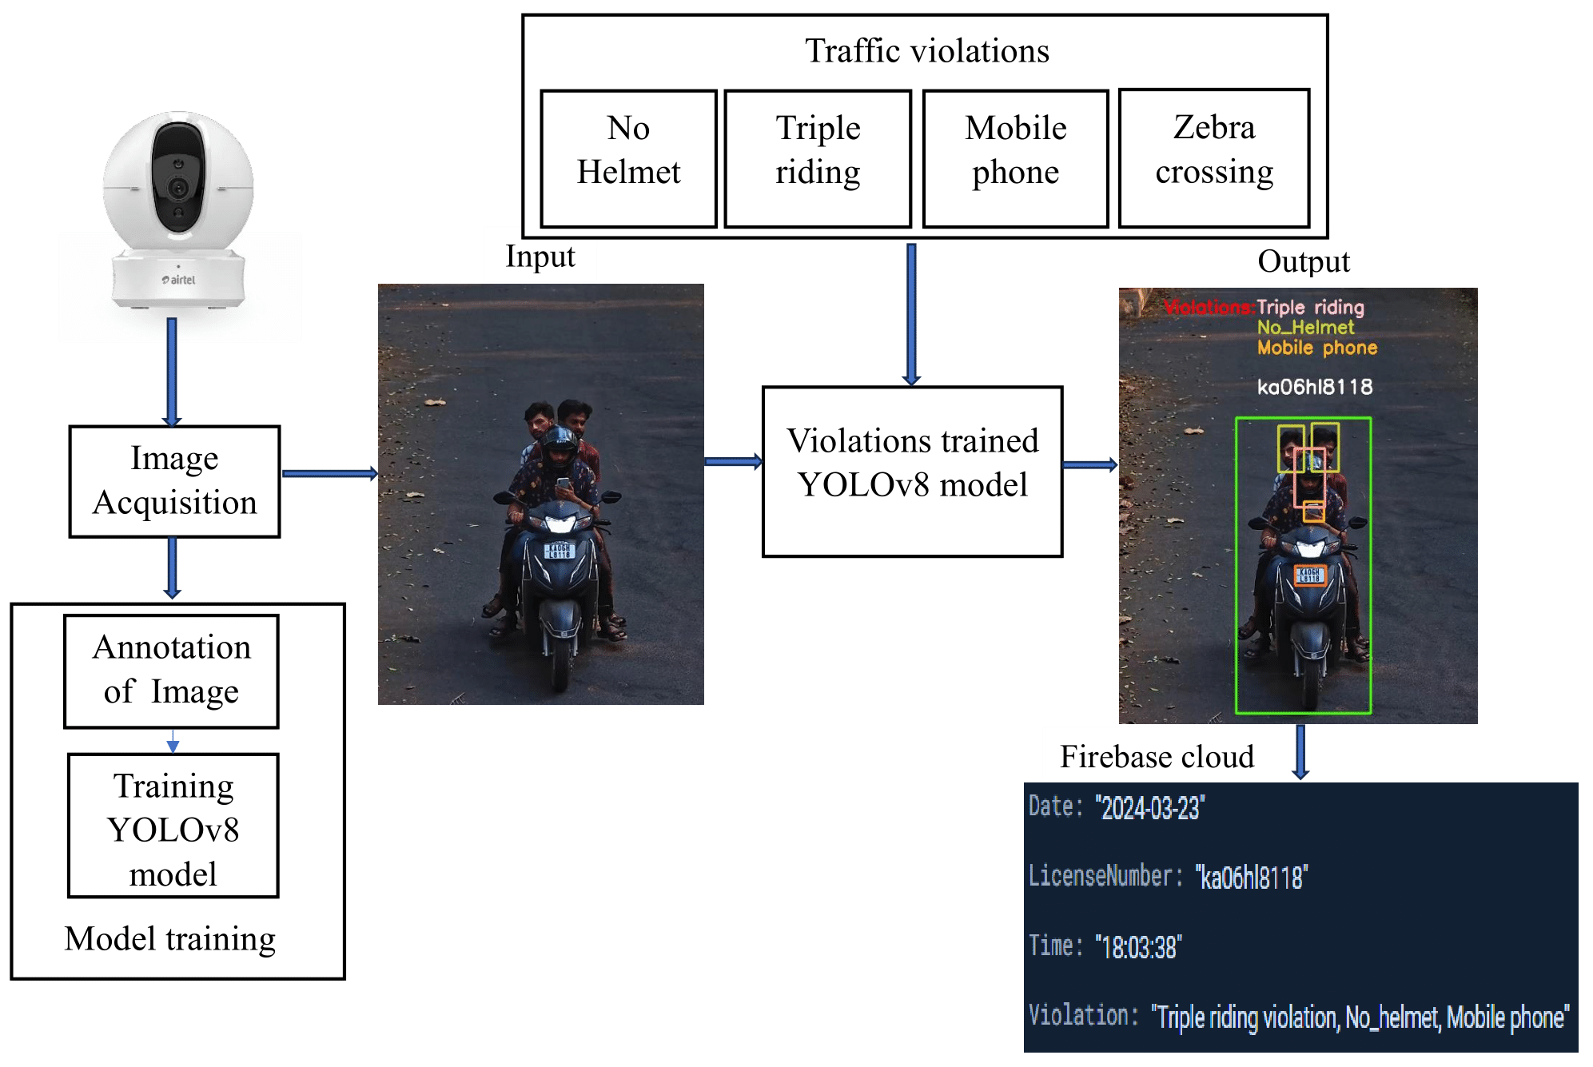
Block diagram
Fig.1. Block diagram of the proposed system

Slide 13
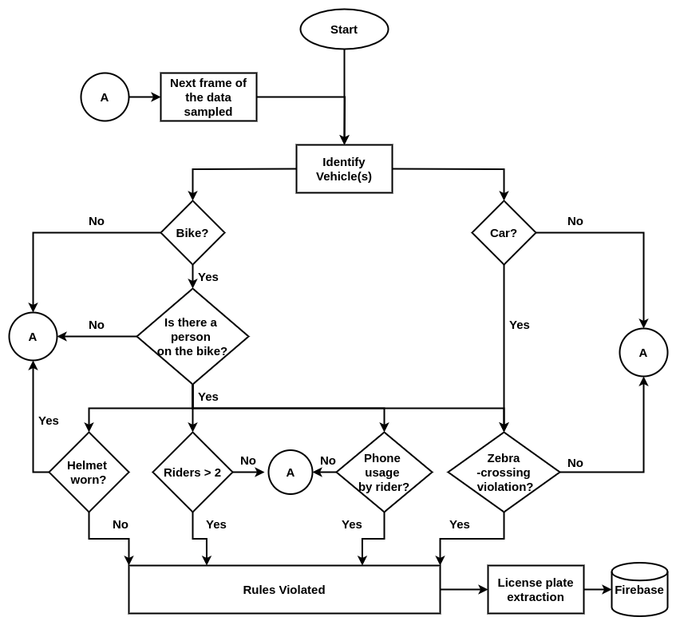
Flow Chart
Fig.2. Work flow of the proposed system

Slide 14
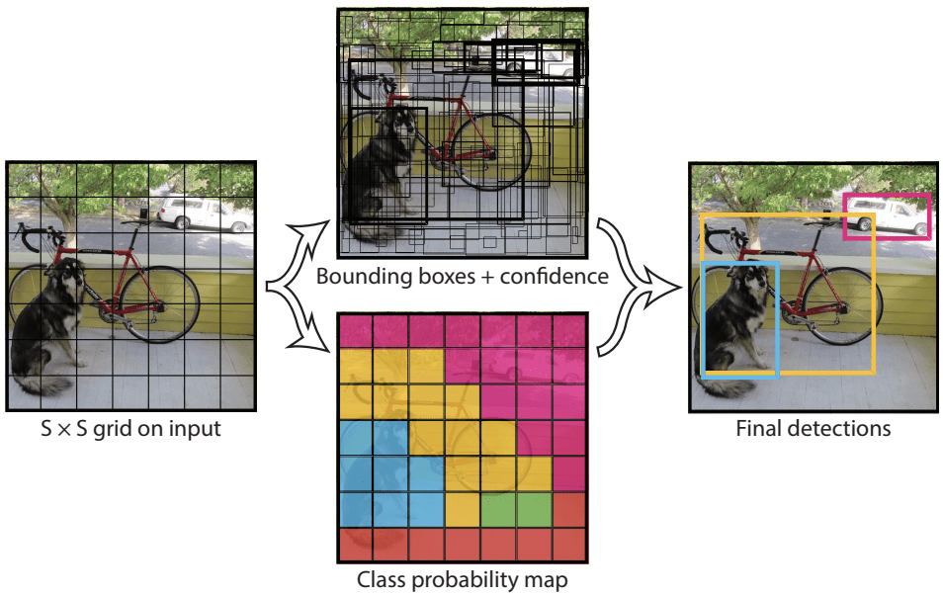
Methodology
Dataset gathering
Annotation of images with a total of 9967 instances
Model training : The training was conducted over 100 epochs using the YOLOv8n model.
Prediction

Slide 15
Methodology (Contd..)
Prediction
Feature Extraction
Multi-Scale Feature Fusion
Grid Division (S x S)
Bounding Box and class probabilities Prediction
Non-Maximum Suppression
Visualization
Drawing bounding boxes
Labelling names and confidence scores

Slide 16
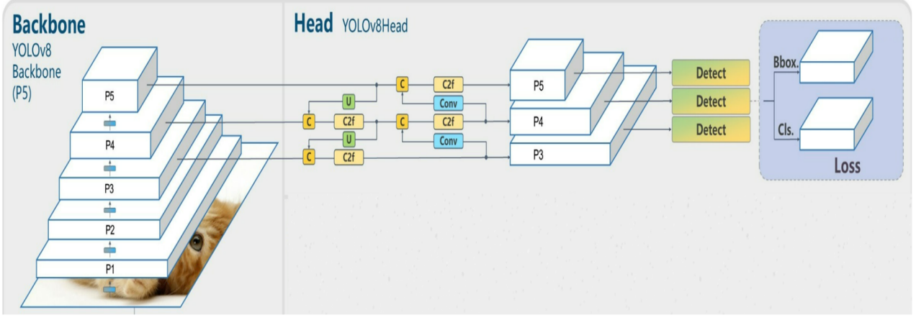
Software Description
YOLOv8 architecture
Courtesy : blog.roboflow.com
Roboflow: Annotation of images.
Google colab: Model training.

Slide 17
Software Description (Contd..)
OpenALPR model framework for license plate information extraction.
Image Acquisition
Image Preprocessing
License Plate Localization
Character Segmentation
Character Recognition
Fig.3. LPR model framework.

Slide 18
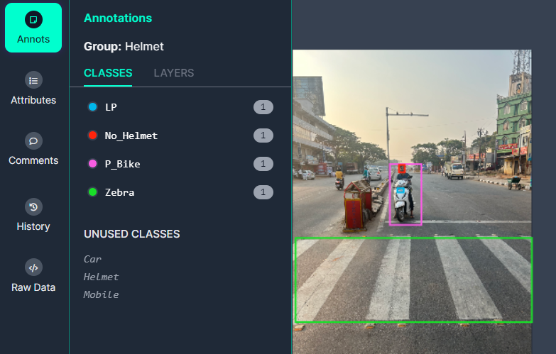
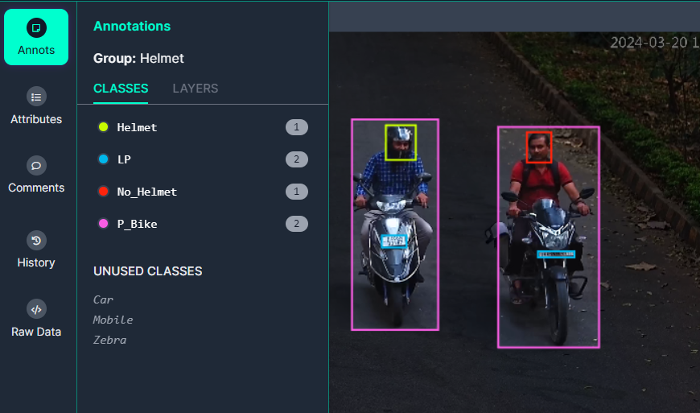
Dataset
The dataset of 2300 images were extracted from 50 videos of 100 hours footage.
The collected images are annotated using Roboflow considering 7 classes with the total annotations of 9967 instances.
The images are resized to 640 x 640.
Dept. of ECE, SIT, Tumkur

Slide 19
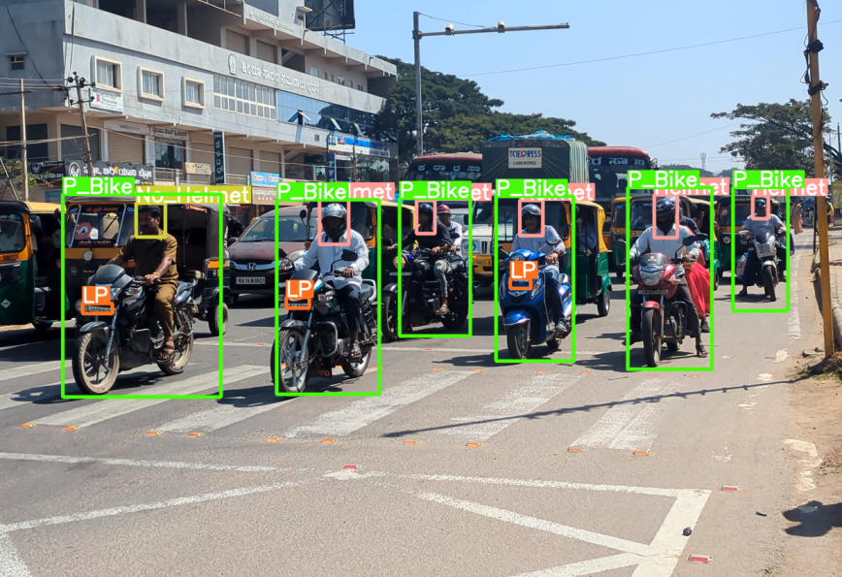
Results and Discussion
The model was tested on approximately 50 videos of 100 hours depicting traffic scenarios in Tumakuru and on the scenarios in SIT campus, considering 20 possibilities in the videos.

Slide 20
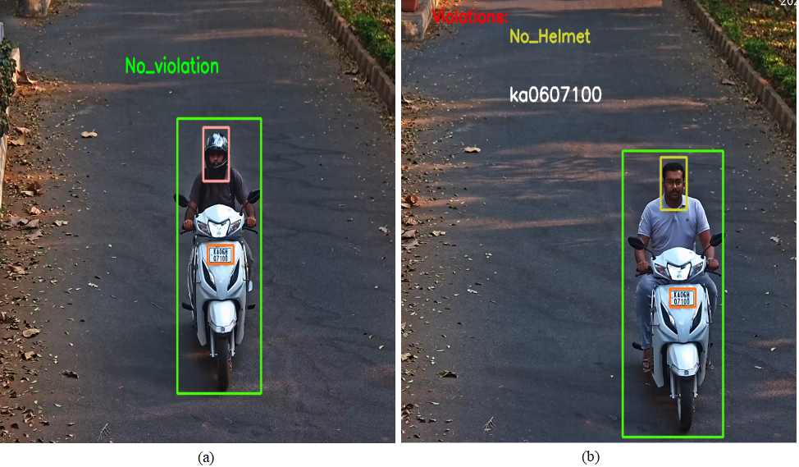
Results (Cont..)
Detecting helmeted and no helmeted rider.

Slide 21
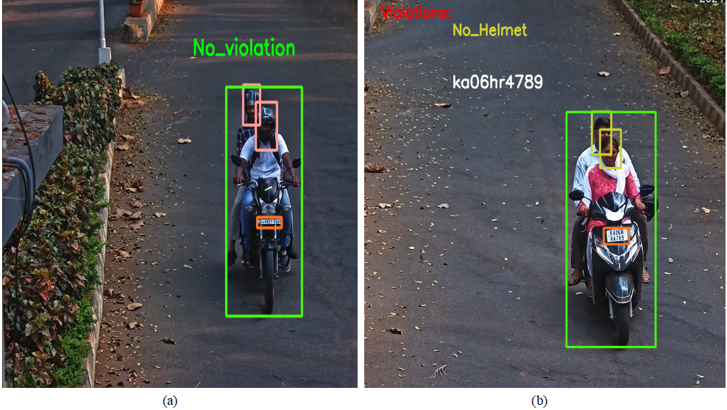
Results (Cont..)
Two riders with helmet and two riders without helmet.

Slide 22
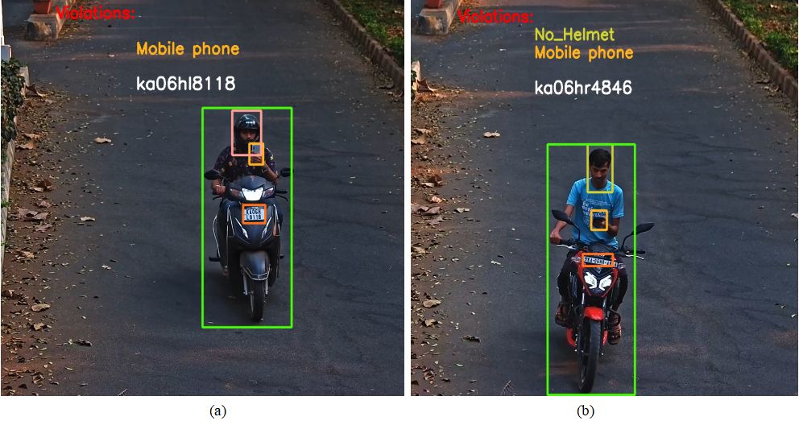
Results (Cont..)
Riders using mobile phone while riding.

Slide 23
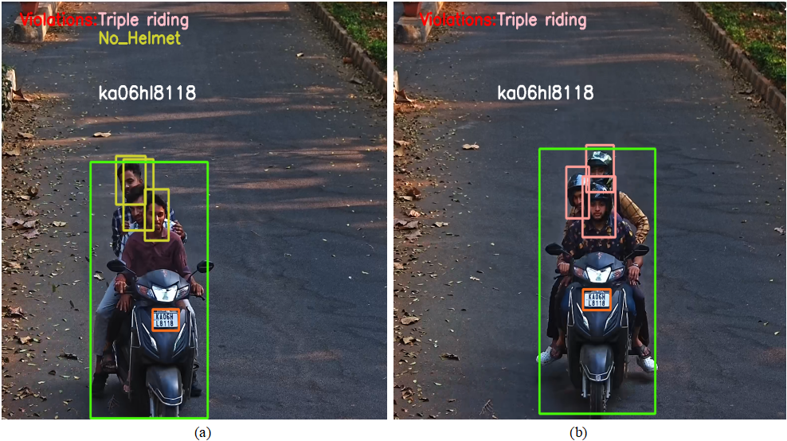
Results (Cont..)
Triple riding on bike.

Slide 24
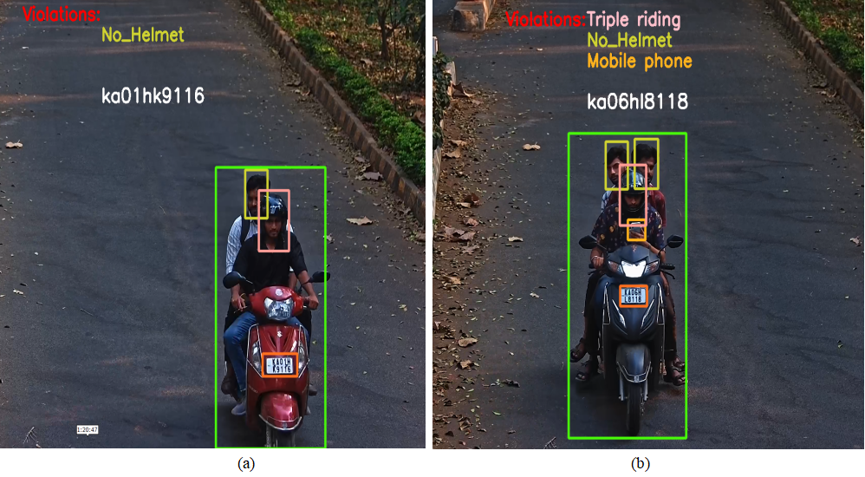
Results (Cont..)
No helmet and triple riding in a bike and using mobile phone.

Slide 25
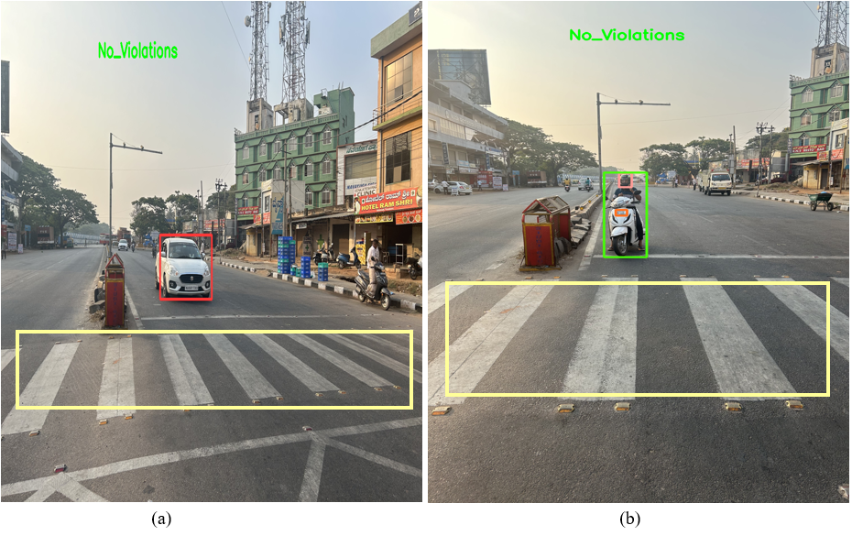
Results (Cont..)
No zebra violation.

Slide 26
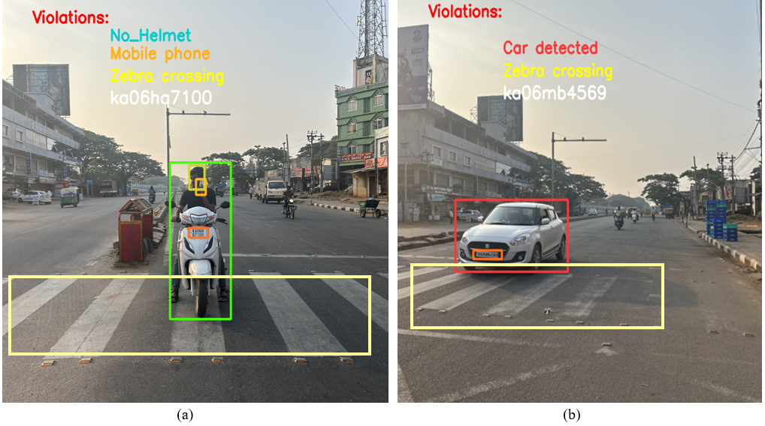
Results (Cont..)
Zebra violation.

Slide 27
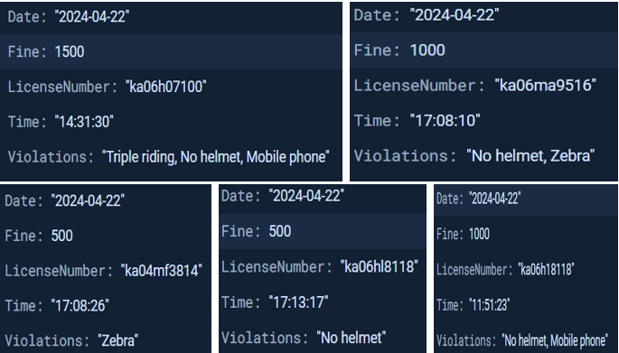
Results (Cont..)
• Storing the data in a Firebase Cloud.

Slide 28
Results (Cont..)
The model achieves a 99% detection rate for bikes and riders. It distinguishes helmeted riders with 99% accuracy and non-helmeted riders with 98% accuracy
Additionally, it detects mobile phone usage with a accuracy of 98% and also identifying instances of more than two riders on a bike with 96% accuracy.
The model achieve an accuracy of 90% in detecting the zebra cross violators for both bikes and cars. The system recognizes the license plate information of the vehicle with an accuracy of 93%.
Overall, the system achieved 97% accuracy in detecting traffic rule violators.
The results are stored in the Firebase Cloud with a violations committed by the rider along with the date and timestamp.
Dept. of ECE, SIT, Tumkur

Slide 29
Conclusion
The system automatically detect traffic violations using the YOLOv8 model, effectively identifying infractions such as riding without a helmet, triple riding and using a mobile phone while riding a bike and also identifies the instances of zebra crossing lane violations for both bike and car.
By extracting license plate details in each scenario, law enforcement agencies can efficiently enforce penalties and promote safer road behaviour, ultimately contributing to a reduction in road accidents and fatalities.
This project reduces the manual monitoring of the traffic scenes by the traffic officers.

Slide 30
Scope for future work
The offences committed could be identified and an SMS can be directly sent to the traffic offender with the fine amount and payment link.
This project lays the foundation for future advancements in smart transportation systems like traffic flow monitoring, anomaly detection and parking management.

Slide 31
References
[1]. K. Dahiya, D. Singh and C. K. Mohan, "Automatic detection of bike-riders without helmet using surveillance videos in real-time," 2016 International Joint Conference on Neural Networks (IJCNN), Vancouver, BC, Canada, 2016.
[2]. A. Saumya, V. Gayathri, K. Venkateswaran, S. Kale and N. Sridhar, "Machine Learning based Surveillance System for Detection of Bike Riders without Helmet and Triple Rides," 2020 International Conference on Smart Electronics and Communication (ICOSEC), Trichy, India, 2020.
[3]. M. Dasgupta, O. Bandyopadhyay and S. Chatterji, "Automated Helmet Detection for Multiple Motorcycle Riders using CNN," 2019 IEEE Conference on Information and Communication Technology, Allahabad, India, 2019.
[4]. X. -H. Wu, R. Hu and Y. -Q. Bao, "Block-Based Hough Transform for Recognition of Zebra Crossing in Natural Scene Images," in IEEE Access, vol. 7, pp. 59895-59902, 2019.
[5]. Mallela Nikhil Chakravarthy, Rohit Volety, and Nadesh R.K., "Detection of the triple riding and speed violation on two-wheelers using deep learning algorithms", Multime dia Tools and Applications, Springer, 2020.
[6]. Mistry, Jimit, Aashishk and kishor P. Upla. “An automatic detection of helemeted and non helemeted motorcyclists with license plate extraction using CNN.”, in International Electrical Engineering Congress (iEECON), Chonburi, Thailand, pp. 1-4,Dec.2014.

Slide 32
References
[7]. H. Lin, J. D. Deng, D. Albers and F. W. Siebert, "Helmet Use Detection of Tracked Motorcycles Using CNN-Based Multi-Task Learning," in IEEE Access, vol. 8, pp. 162073-162084, 2020.
[8]. H. Shi and D. Zhao, "License Plate Recognition System Based on Improved YOLOv5 and GRU," in IEEE Access, vol. 11, pp. 10429-10439, 2023.
[9]. W. Riaz, A. Azeem, G. Chenqiang, Z. Yuxi, Saifullah and W. Khalid, "YOLO Based Recognition Method for Automatic License Plate Recognition," 2020 IEEE International Conference on Advances in Electrical Engineering and Computer Applications( AEECA), Dalian, China, 2020.
[10]. A. N. Mukunda Rao, Nikhil Kumar, Gaurav Kumar Sahu, Ravi M, Sahil Kumar, Sukruth V, “Triple Riding and No-Helmet Detection”, 2022.

Slide 33
THANK YOU.

